Slide 1





Guided learning with
AVATARS and YOU – INTERACTIVE LEARNING
© 2026 – The Family history guide Association

Slide 2
Inside guided learning …
What is Guided Learning?
1
How is it different?
2
How does it work?
3
How can people use it?
4
Where are the videos?
5

Slide 3

1. What is guided learning?
Guided Learning is an interactive learning experience for family history.
AI avatars guide you through essential material in The Family History Guide website.
Guided Learning is ideal for either individual or group learning.

Slide 4

2. How is it different?
Rather than watching traditional webinars, the learner is fully engaged in exploring articles, videos, and databases in The Family History Guide.
Learners can expand the scope of each lesson with additional resources in TFHG.
No instructor is required.

Slide 5

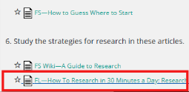
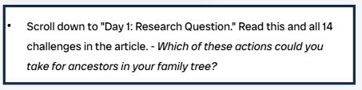
3. How does it work?
2. In the video screen, click the article, video, or database link indicated in red. This opens the item in a separate browser tab.
3. In the Guided Learning video, read the instructions in the box and answer the questions, based on what you learned in TFHG.
1. Click the link in the Guided Learning video to open the topic in The Family History Guide (TFHG), in a separate window.

Slide 6
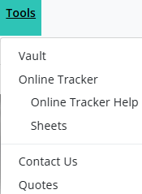
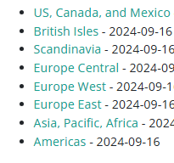
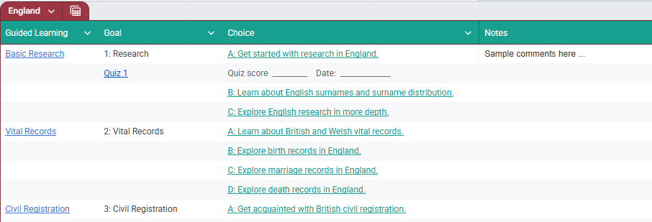
Taking notes
For each Guided Learning video, users can take notes, such as with Online Tracker Sheets in TFHG.
Open a sheet and download it for a custom notes space, connected to The Family History Guide.

Slide 7
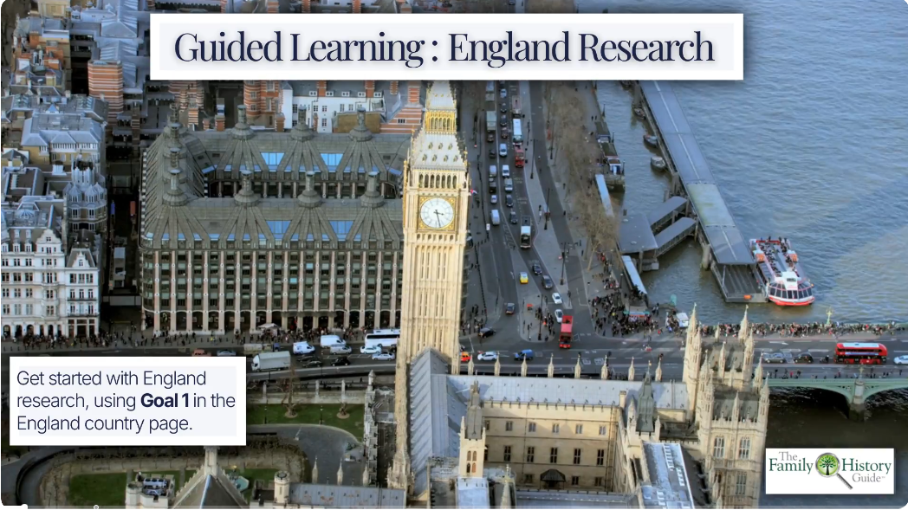
GUIDED LEARNING In action
Click the picture to launch a sample Guided Learning video. Then watch the first minute of the video to see it in action.

Slide 8

4. How do you use it?
Without instructor: Learners use the Guided Learning videos for independent learning.
With instructor: Show each video in a group setting and lead discussions for each slide.
Curriculum design: Combine Guided Learning videos into courses of study, such as research skills, research in countries, etc.

Slide 9
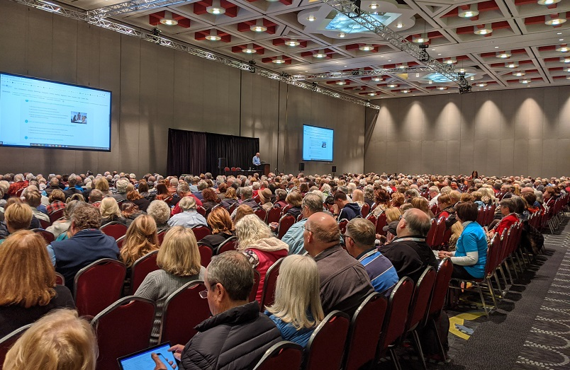
Who else could use guided learning?
Genealogy societies
Genealogy clubs and SIGs
Libraries
Schools and home school
Church groups
Facebook groups and others on social media

Slide 10
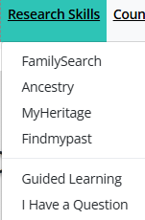
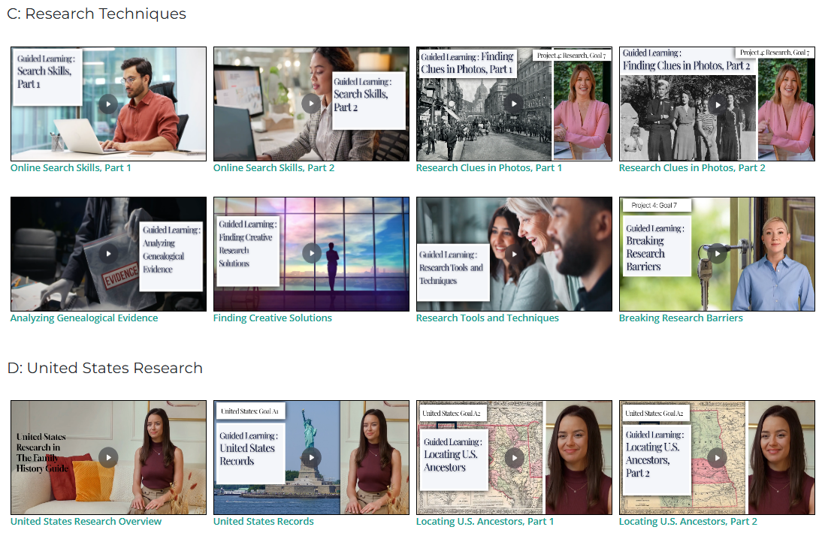
5. Where are the videos?
https://www.thefhguide.com/guided-learning.html
Over 100 Guided Learning videos to choose from
Many more on the way
Language translations coming for Spanish, French, and Portuguese

Slide 11
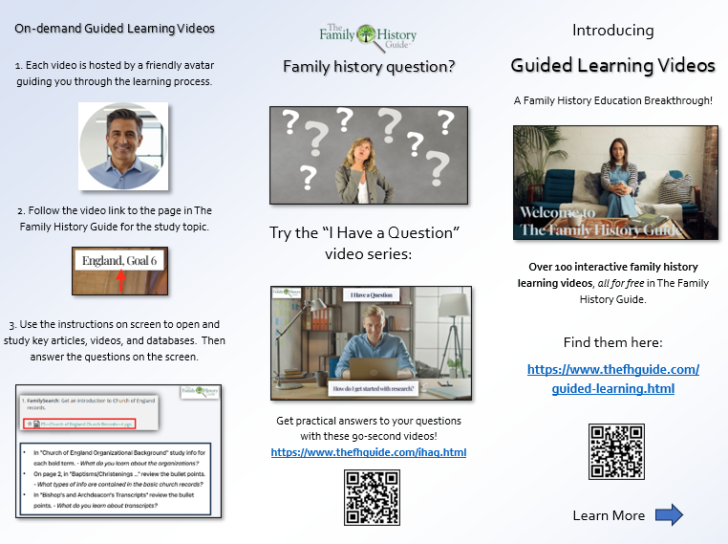
The guided learning brochure
Explains Guided Learning and its features.
Reverse side of PDF has links to most of the Guided Learning videos.
https://www.thefhguide.com/TFHG-Guided-Learning

Slide 12
FAQs
1: How are the articles selected in TFHG?
A: They are usually shorter, with headings or bullet lists for easy organization.
5: May I modify Guided Learning videos?
A: Guided Learning videos may not be modified or copied without written approval from The Family History Guide Association.
2: How are videos selected in TFHG?
A: They are also usually shorter, often as webinars with clear slides.
6: Are all Guided Learning videos about doing research?
A: Most are, but some explain features of The Family History Guide website.
3: How are websites & databases selected?
A: They are easy to navigate, with valuable resources that are free to access.
12

Slide 13
Key Concepts
First, we select the ideal articles and videos. Then we select the key content inside the articles and videos for study.
Each Guided Learning video is only about 3 minutes long, but completing the instructions can take 20-30 minutes.
To respect copyrights, we don’t reproduce article or video content. We point to it and ask questions about it.
Because learners pause each video often, they are free to explore more items in The Family History Guide.
The AI avatars welcome and guide learners from screen to screen, but they don’t do the teaching. That’s what the instruction boxes are for.
Guided Learning questions are open-ended and exploratory, for discovery. There are no quizzes, but there are practice exercises and databases to explore.
13

Slide 14


THANK YOU!
Find out more about guided learning at
https:// www. thefhguide. com/guided-learning.html

